Slide 1
EDA Analysis Beer and Breweries Budweiser
Presented by: Carlos Estevez and Haitie Liu

Slide 2
Objectives
Introduction
Important facts of Budweiser
Definition of IBU and ABV
Difference between IPA and PALE
Answer the question of the EDA
ChatGPT Analysis

Slide 3
Introduction
In this EDA(Exploratory Data Analysis) we will conduct an analysis about beers sold across different states in the United States
Show the different beer’s styles managed by each brewery in each state
Analysis of business areas that the Budweiser corporation could improve: Customer service and Inventory Management
Strengthen their Budweiser’s position in the market and translating these benefits to the final customer

Slide 4
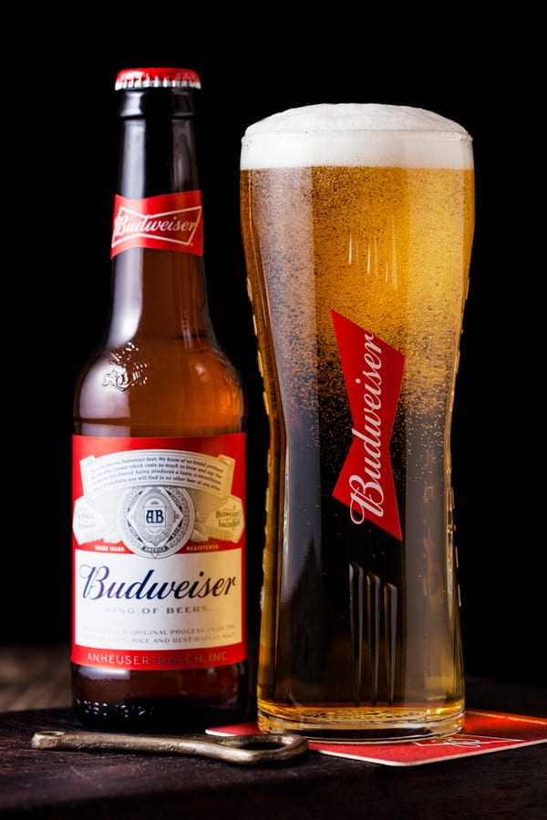
Important facts
Budweiser is an American-style pale lager
Americans were mostly drinking heavy in the 1850s
Budweiser created refreshing light lager perfect for hot summers
Budweiser is classified as an American lager
Image 1: Budweiser beer

Slide 5
IBU and ABV
Two characteristics used to describe styles : Alcohol by volume (ABV) and international bitterness unit (IBU)
ABV represents the percentage of alcohol in the beer
Beers with a higher ABV have a more bitter flavor
IBU is a measurement of the number of bitter flavor compounds in a beer.
The IBU scale fall between 5 IBUs and 120 IBUs. Anything higher than 120 can't be detected by the average palate
Notes:
Haitie Liu

Slide 6
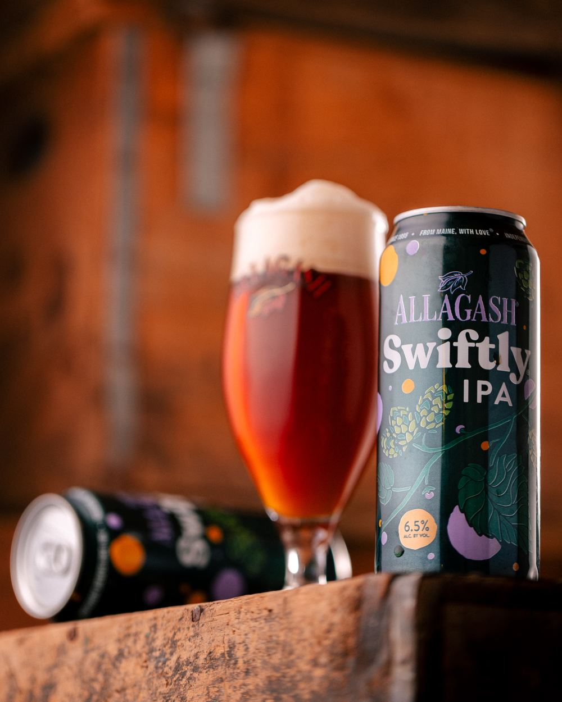
IPA and PALE
Pale ale and IPA (historically called India Pale Ale) are two of the most well-known beer styles
IPAs will have bigger flavors and slightly higher ABV than Pales
Pale ales will usually be between 4.5 – 6.2% ABV
IPAs will usually sit between 5 – 7.5% ABV
IPAs tend to have higher ABV and IBU
Image 1: Budweiser beer
Notes:
Haitie Liu

Slide 7
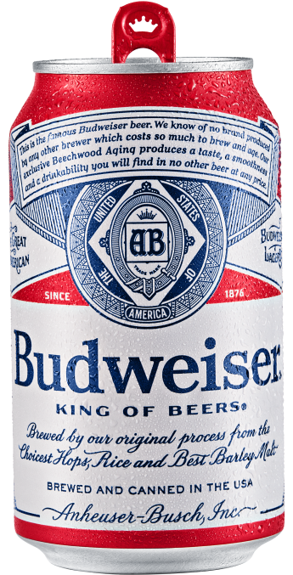
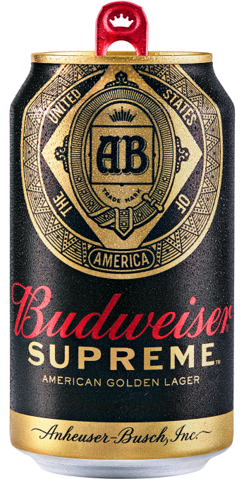
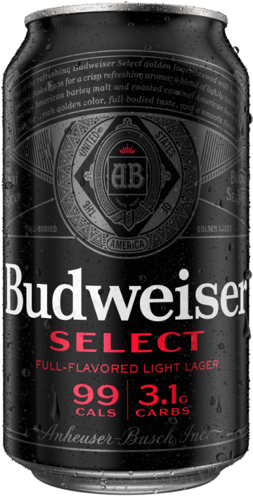
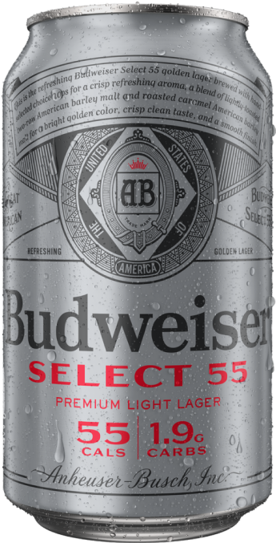
Product Lineup
Stats
King of Beer
ABV % – 5.0%
IBU – 12
CAL – 145
Stats
Budweiser Supreme
ABV % – 4.6%
IBU – 10 ~ 12
CAL – 143
Stats
Budweiser Select
ABV % – 5.0%
IBU – 10
CAL – 99
Stats
Select 55
ABV % –2.4%
IBU – 12
CAL – 55
Notes:
Haitie Liu

Slide 8
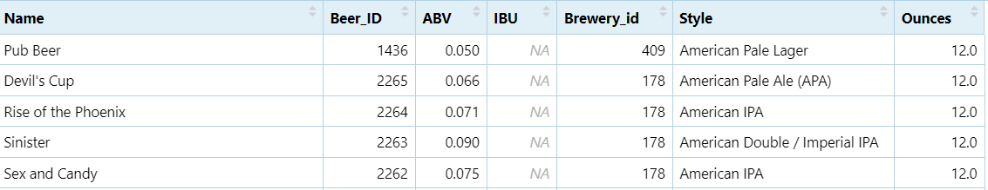
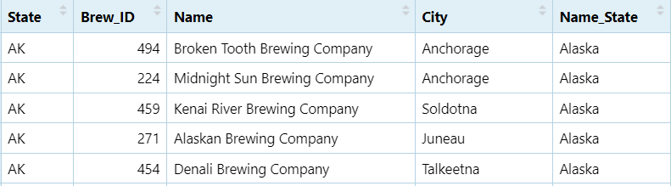
Datasets
We have two datasets as a source of information
Df_Beers: Beers.csv
Df_Breweries: Breweries.csv
Notes:
Haitie liu

Slide 9
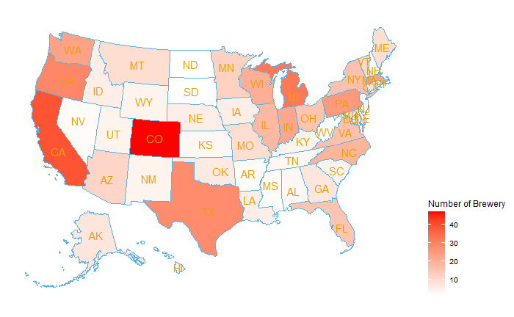
1.How many breweries are in each state
Colorado: 47
California:39
Michigan:32
Oregon:29
Texas:28
The Big 5:
Accounts for 32% of craft breweries in the United States, producing whopping close to 50% of all known craft beers in the country!
These States are beer powerhouse!

Slide 10
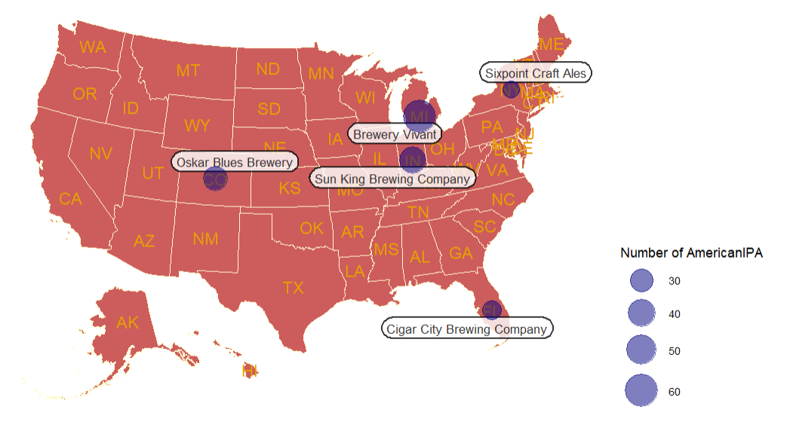
1.The Top Breweries The Big 5
Oskar Blues Brewery
Cigar City Brewing Company
Sun King Brewing Company
Brewery Vivant
Sixpoint Craft Ales
If we are planning an acquisition, Brewery Vivant is definitely worth looking at

Slide 11

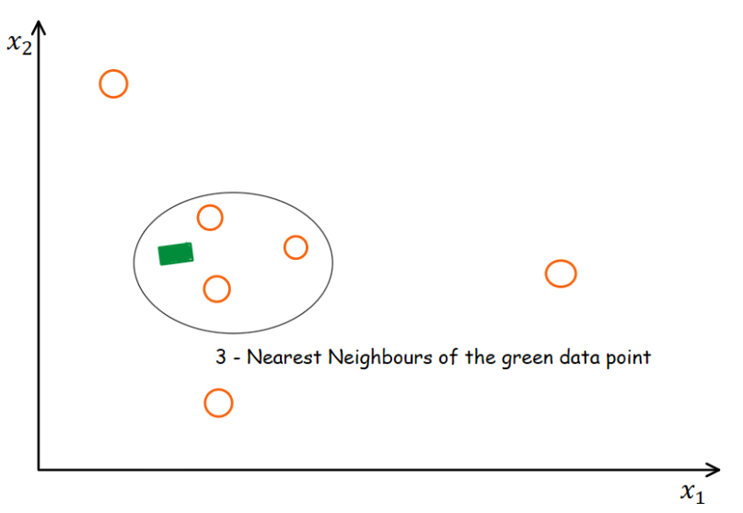
3.Analysis of missing values
Data Cleaning is one of the important steps in an EDA
Handling missing values is part of the Data Cleansing activities
Missing values datasets
Dataset DF_Beers: ABV:62 missing values,IBU: 1005 missing values
Approaches to deal with the missing values in our dataset
ABV→Replacing missing values using Mean
IBU→Replacing missing values using KnnImputation
Image 1: Data Cleansing
Image 2: KNN Imputation IBU

Slide 12
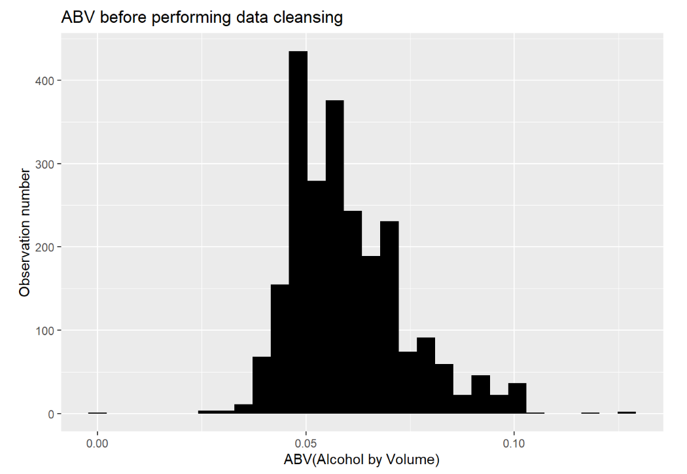
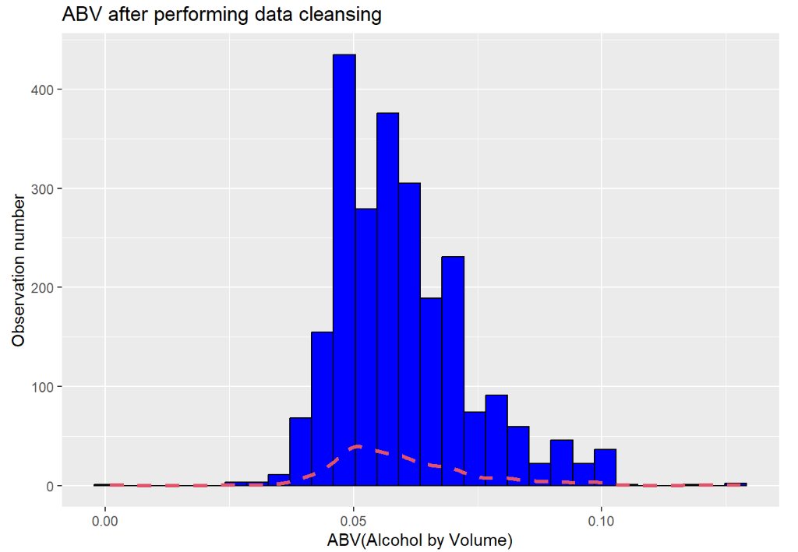
3.Analysis of missing values
ABV Replacing missing values
To tackle missing values for ABV with opted for replacing these missing observation with the arithmetic mean
Resulting dataset
Great

Slide 13
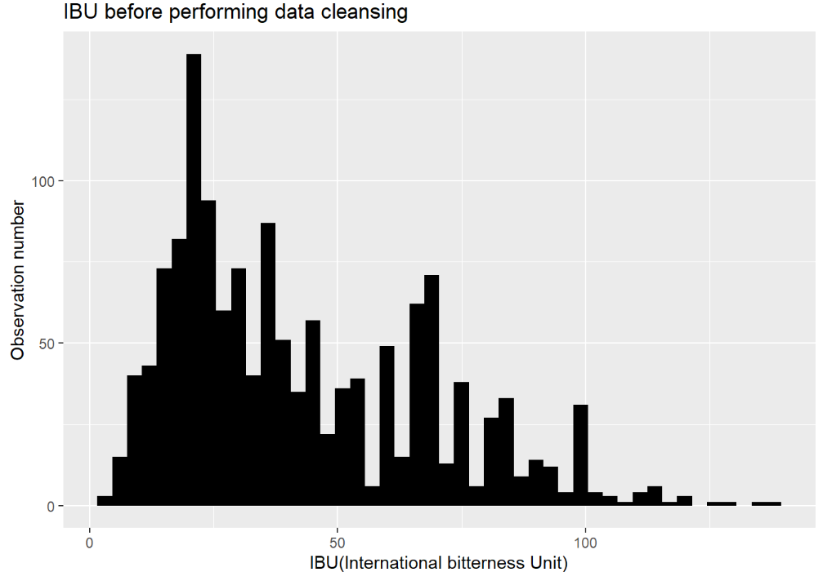
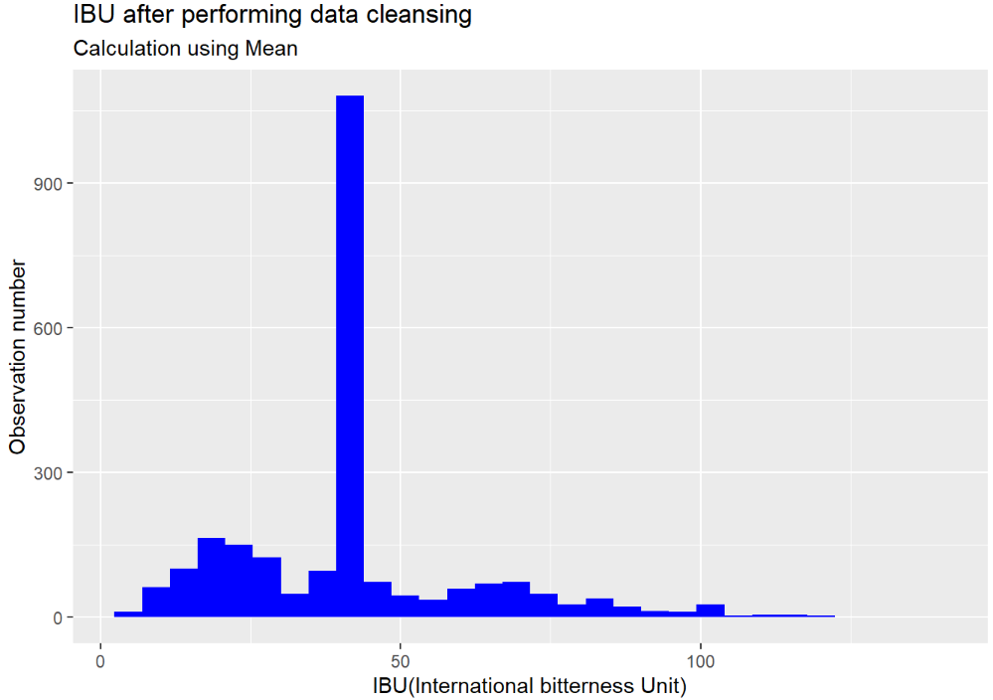
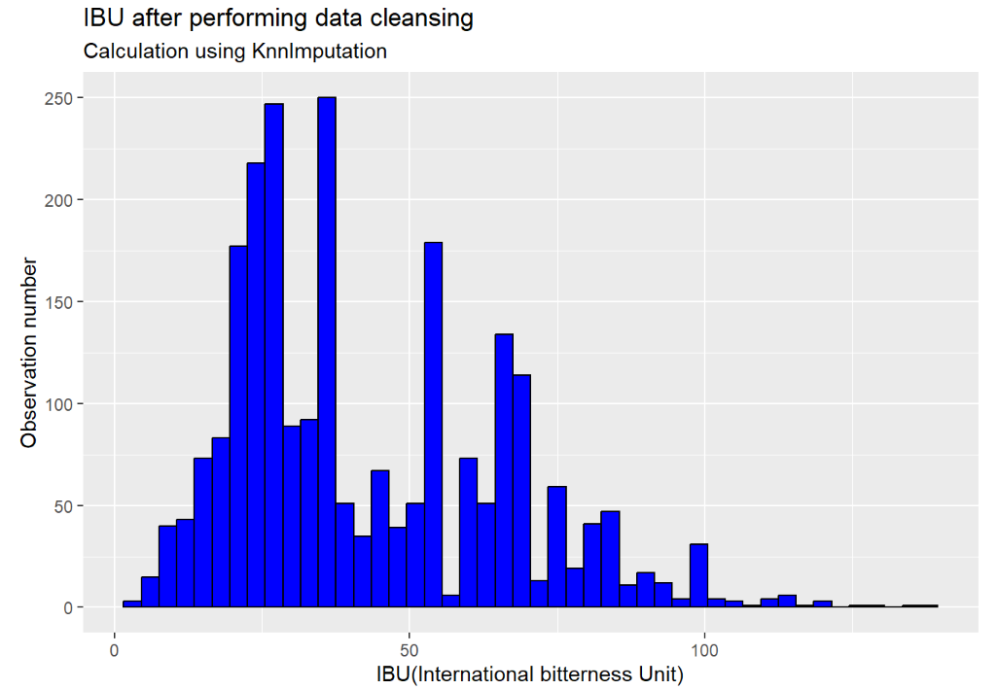
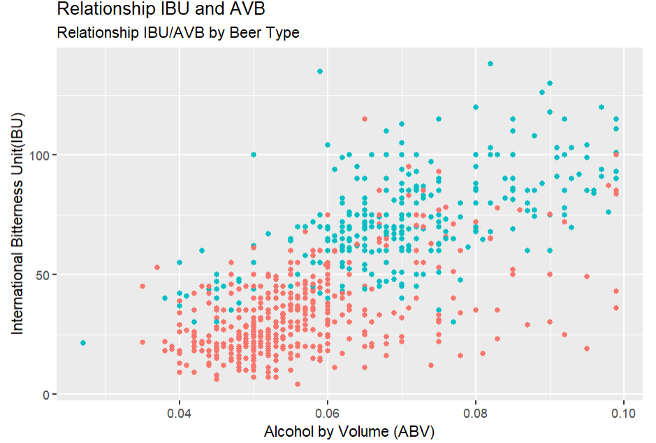
3.Analysis of missing values
IBU Analysis Missing values
Large number missing values
Replacing missing values with the mean is a bad idea
Find a sophisticated method to deal with this problem
There’s a positive relationship between IBU and ABV
KNN imputation method to replace missing values with more plausible values
The resulting distribution is very similar to the original
Bad idea
Great

Slide 14
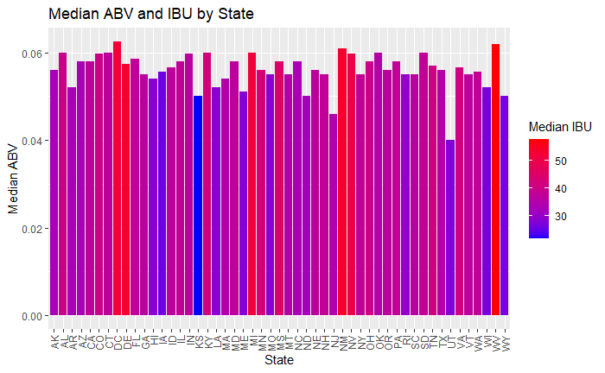
4. Median ABV AND IBU by State
KS has the lowest Median IBU, while WV has the highest Median IBU.
Utah has the lowest Median ABV, while DC has the highest median ABV.
It is interesting that West Virginia has both the highest IBU and ABV

Slide 15
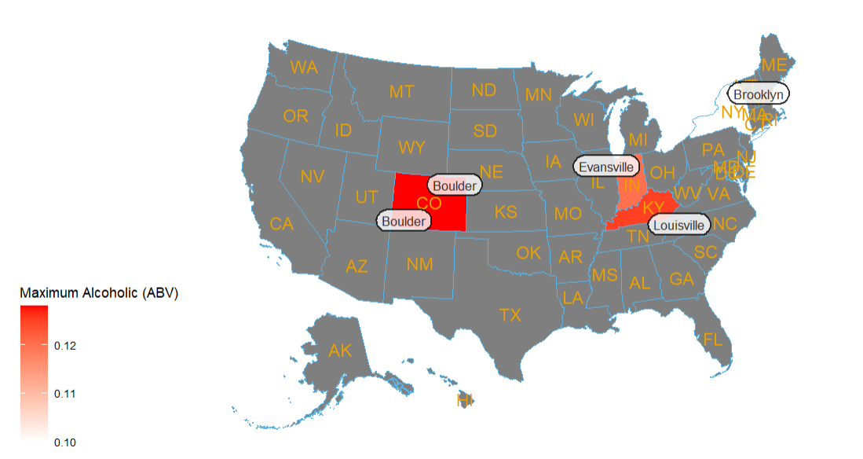
5. Top 5 ABV Beer In Each State
1.Lee Hill Series Vol. 5 - Belgian Style Quadrupel Ale
From Boulder,Colorado
ABV:0.128
2. London Balling
From:Louisville,Kentucky
ABV:0.125
3. Csar
From: Evansville,Indiana
AVB:0.120
4. Lee Hill Series Vol. 4 - Manhattan Style Rye Ale
From: Boulder,Colorado
ABV:0.104
5. 4Beans
From: Brooklyn, New York
ABV:0.100

Slide 16
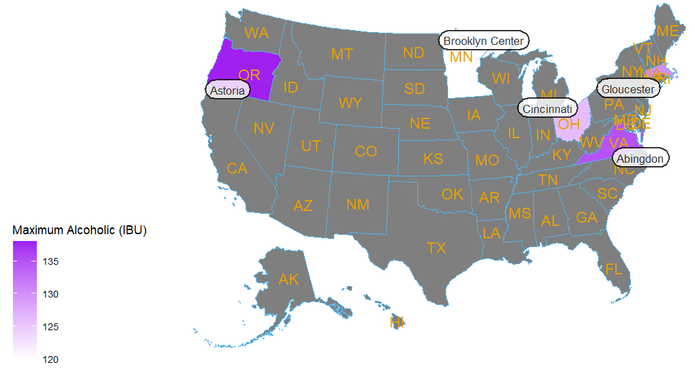
5. Top 5 IBU Beer In Each State
1.Bitter Bitch Imperial IPA
From Astoria,Oregon
IBU:138
2. Troopers Alley IPA
From:Abingdon,VA
IBU:135
3. Dead-Eye DIPA
From: Gloucester,MA
IBU:130
4.Bay of Bengal Double IPA (2014)
From: Cincinnati,OH
IBU:126
5. Abrasive Ale
From: Brooklyn Center,Minesota
IBU:120

Slide 17
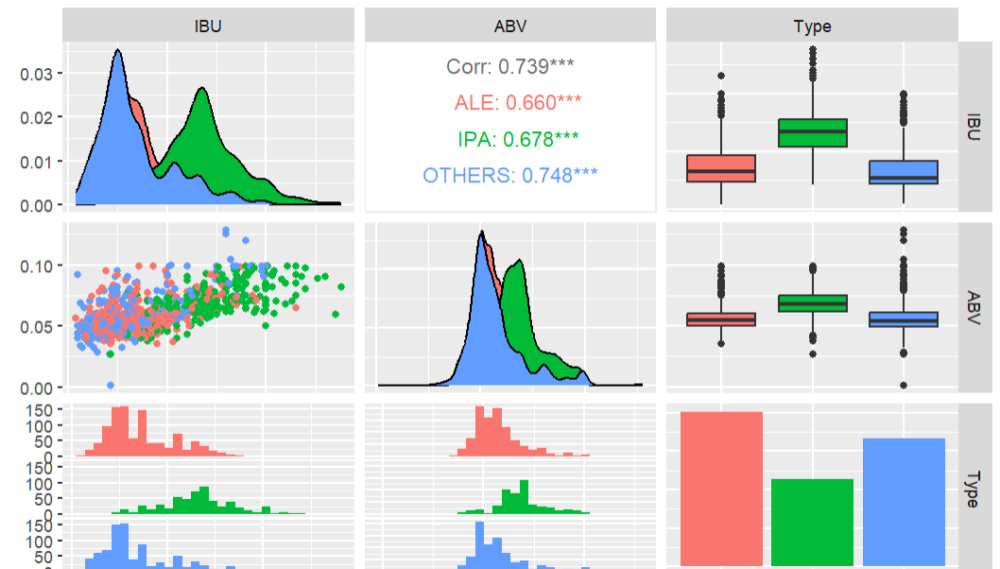
5. Summary Statistics
IPA tends to have have higher percentage of ABV
we can suspect that there is positive linear correlation between IBU and ABV.
Statistical Summary
Kurtosis: 1.24
Skewness: 0.97

Slide 18
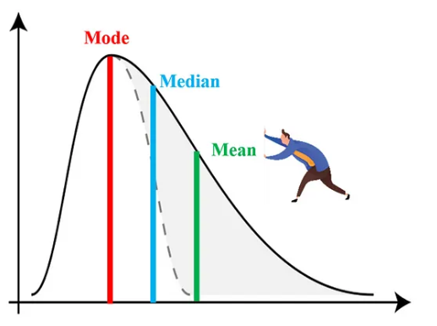
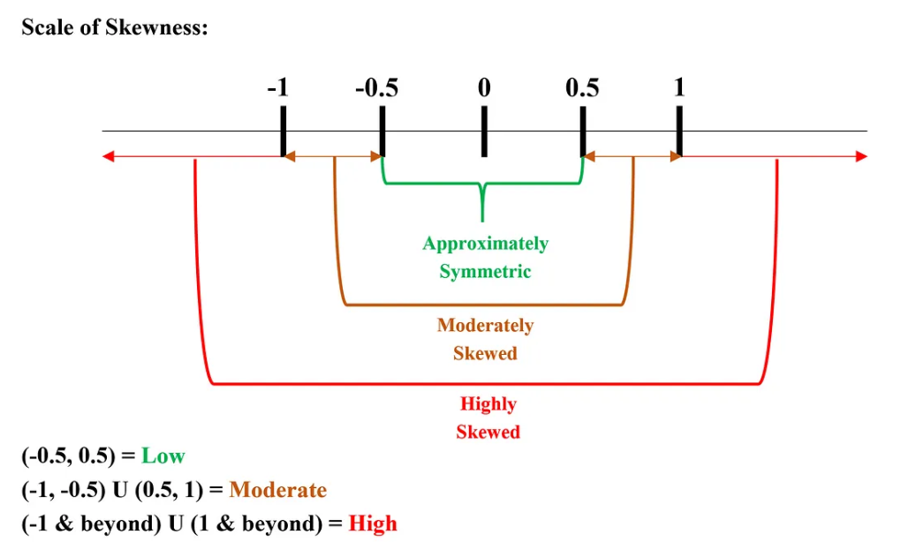
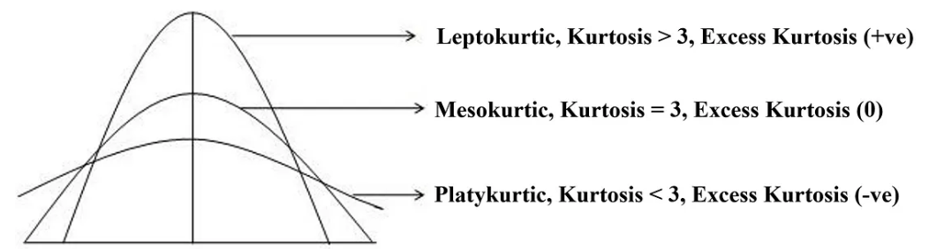
6.Summary statistics and distribution ABV
Statistical Summary
Summary statistics and distribution ABV
This is a moderately right skewed distribution
The Mean is slightly greater than the Median
Skewness:
Symmetric distribution: Skewness is BT-0.5 and 0.5
Moderately skewed Dist.: BT -1 and -0.5 or BT 0.5 and 1
Skewness is less than -1 or greater than 1, the distribution is highly skewed
A normal distribution has a kurtosis of 3
Kurtosis: 1.24
Skewness: 0.97

Slide 19
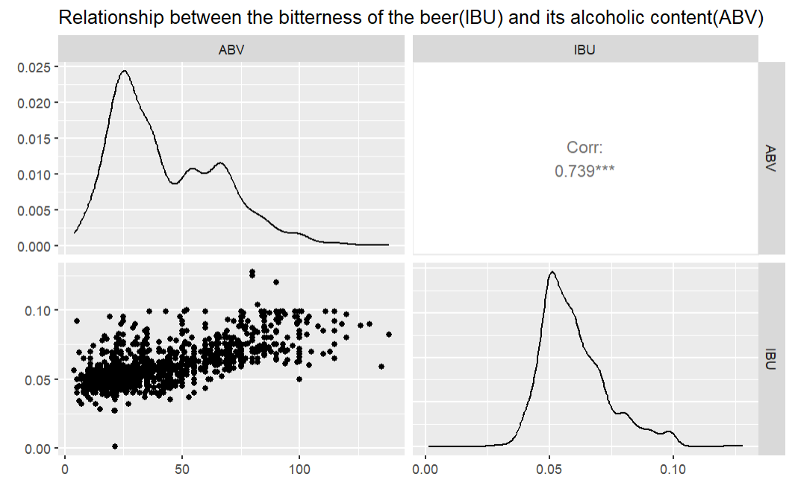
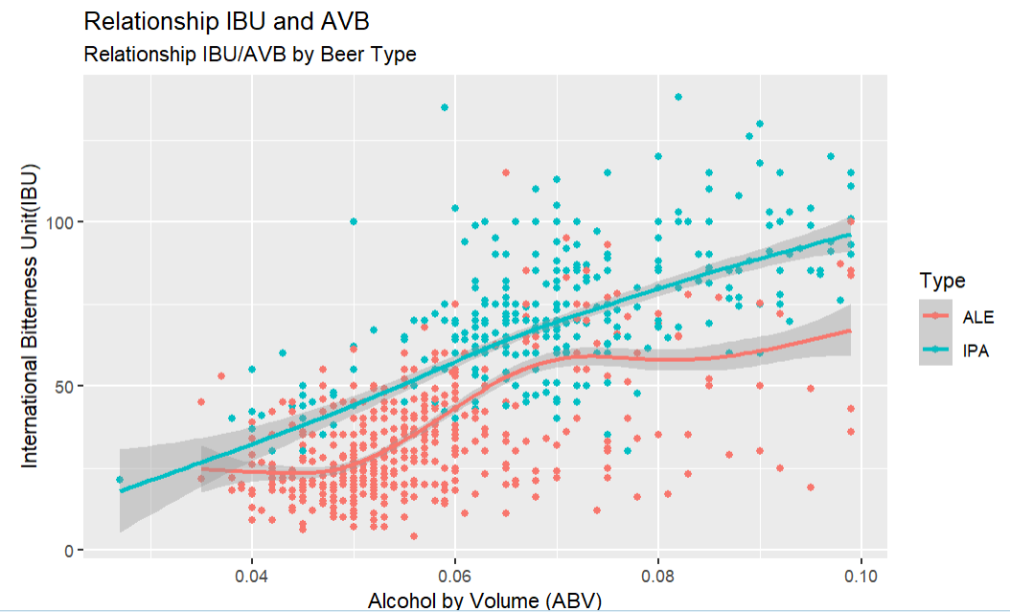
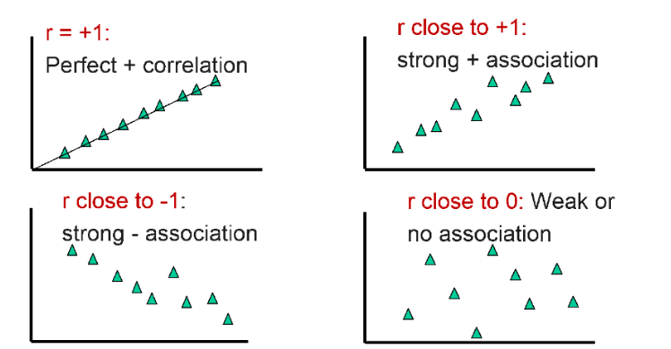
7.Relationship between IBU and ABV
Relationship between IBU and ABV
Strong positive linear relationship between IBU and ABV
IPAs tend to have higher ABV and IBU
The correlation coefficient also confirms the linear relationship

Slide 20
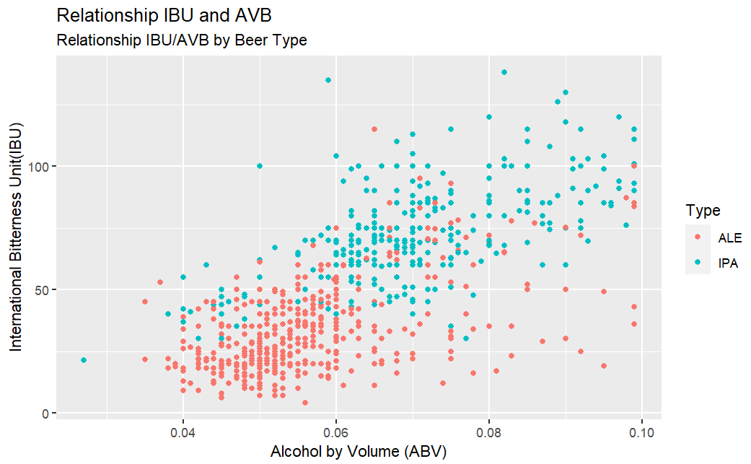
8.Difference between IPA and PALE Beer types
Difference between IPA and PALE
IPA beer types high level of IBU and ABV
ALE beer types less level of IBU and ABV
Pale ales will usually be between (0.045 - 0.062)ABV
IPAs sit between 0.05 –0.075 and more for a double IPA(0.075 – 0.10) ABV
IPAs slightly more bitter

Slide 21
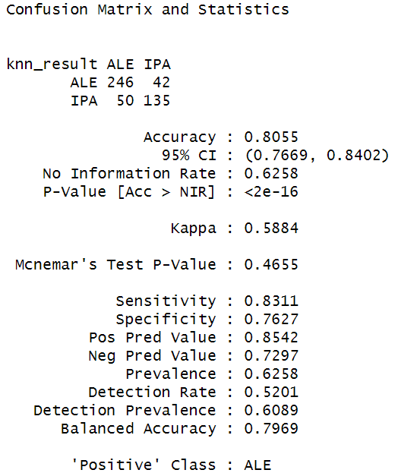
8.Difference between IPA and PALE Beer types
Using KNN to proof difference:
The accuracy of KNN is very high
There’s a clear difference between IPA beers and the rest
KNN easily can classify when a beer is IPA or a beer is a Pale
Both group have a clear difference of bitterness and alcohol

Slide 22
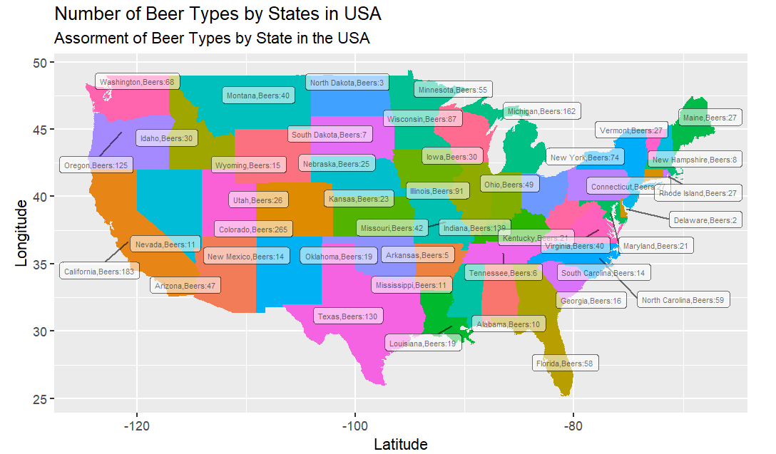
9.Analysis of Beer Assortment by State

Slide 23
9.Analysis of Beer Assortment by State
Comments
The map shows the information about the number of beers or SKU by state in the United States
There are states with more beers than others
California has a large number of beers by style 183 and Dakota has only 3 beers by style
Important role in two different areas: Advertising strategy and Inventory management
Invest capital in advertising strategy in California and Colorado because of the level of consumption of beer
Don’t invest too much money in states like Dakota
Keep a high service level and a good safety stock in states like California or Colorado
Prevent getting stock out in those states since it seems they bring the most profit to the company
Notes:
Comments
The map shows the information about the number of beers or SKU by state in the United States
There are states with beers than others
California has a large number of beers by style 183 and Dakota has only 3 beers by style
This data will play an important role in two different areas:
Advertising strategy
Inventory management
It is a great idea to invest capital in advertising strategy in states like California and Colorado because of the level of consumption of beer. We don’t have selling information however, we can notice by the wide assortment of California that the demand of beer is really high and more importantly the customers are willing to purchase more style of beers. On the other side, it doesn’t make sense to invest too much money in States like Dakota because it seems that demand of beers is very low.
In terms of Inventory Management, it is recommendable to keep a high service level and a good safety stock in states like California or Colorado aiming to provide a great customer service. We have to prevent getting stock out in those states

Slide 24
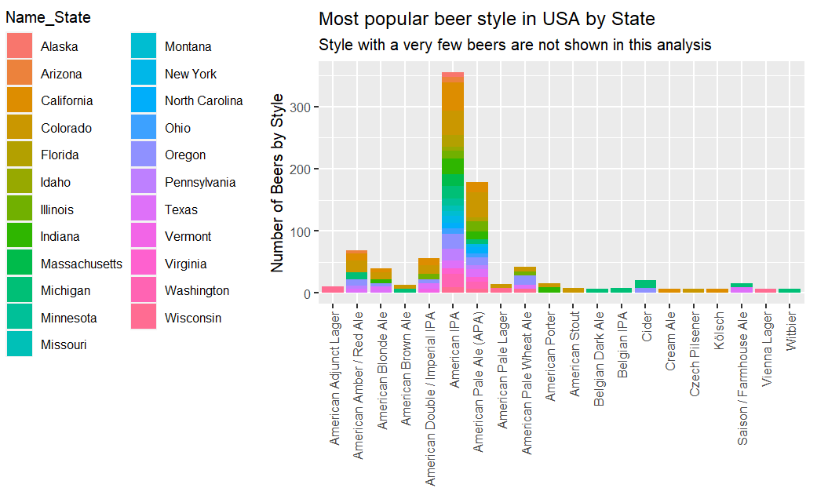
9.Most popular beer styles

Slide 25
9.Most popular beer styles
Comments
The image shows the number of beer by style in each state
Most popular beer styles in every state in USA
The company can focus on these important beer styles in the future
Budweiser is a American-style lager not an American IPA , they can lunch a new beer based on this style

Slide 26
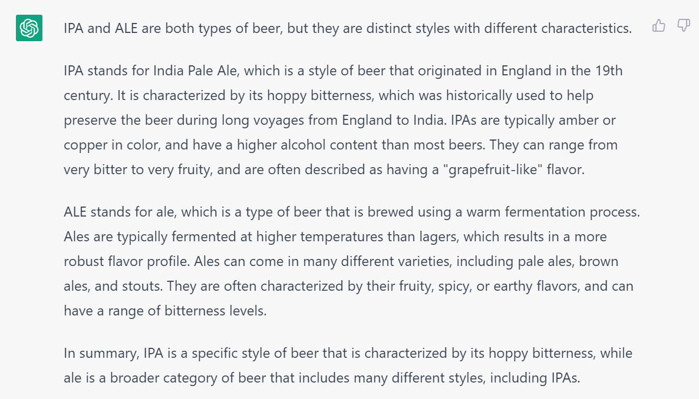
10.Chat GPT Questions
What is the difference between IPA and ALE Beer?

Slide 27
10.Chat GPT Questions
What is the difference between IPA and ALE Beer?

Slide 28
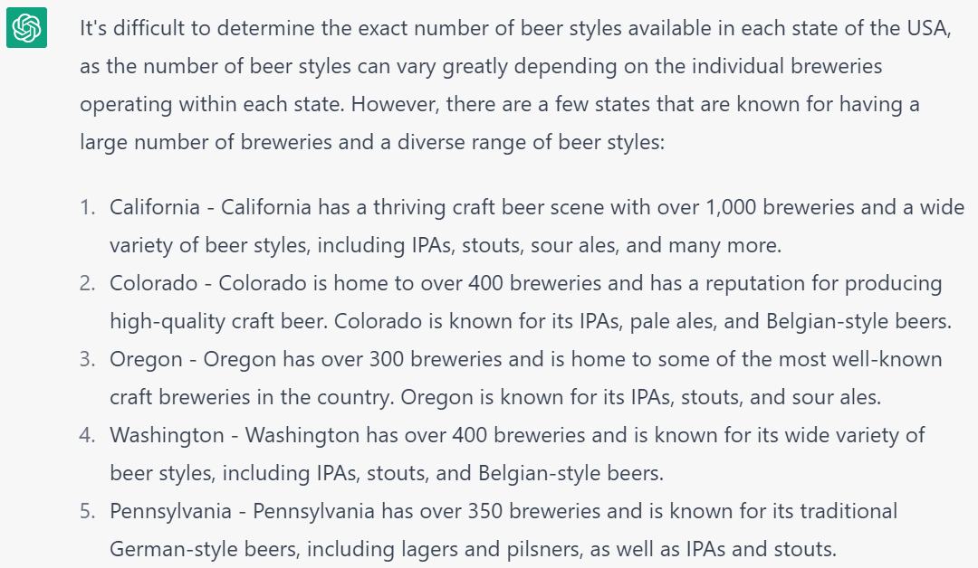
10.Chat GPT Questions
What are the states in USA with more beer styles?

Slide 29
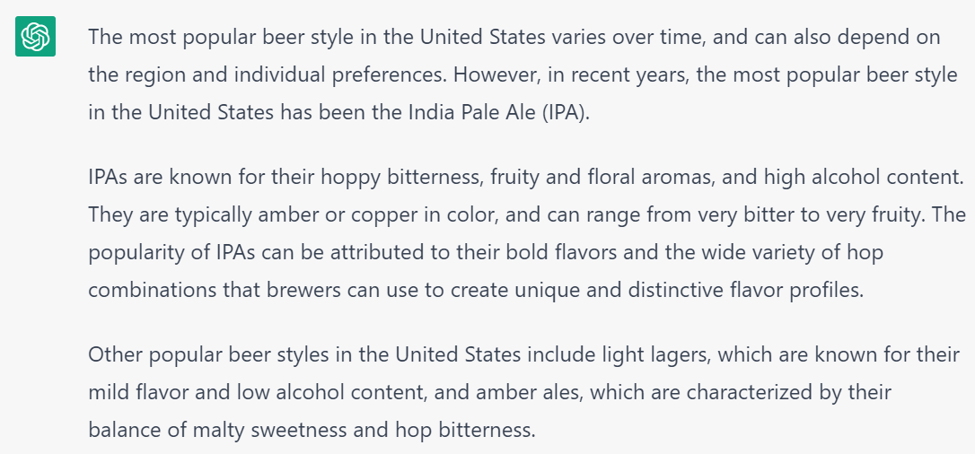
10.Chat GPT Questions
What is the most popular beer style in the United States??

Slide 30
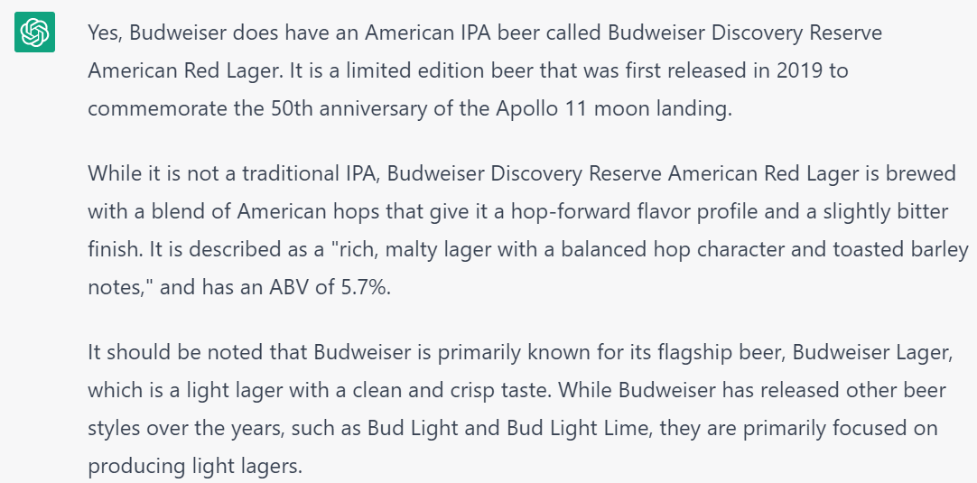
10.Chat GPT Questions
Does Budweiser have an American IPA beer?

Slide 31
10.Chat GPT Questions
We ask several questions to ChatGPT and the answers are in alignment with our recommendations and conclusion. For example, in question 1 we asked ChatGPT about the differences between an IPA and a PALE beer and the answer was very similar to ours
In question 2, we asked about the most popular states in terms of the array of beer styles. The response of ChatGPT was the same as California and Colorado
Finally, question 4 was the most challenging. One of our strong recommendations to Budweiser was launching a new product in the IPA category given the fact that this is the most popular beer style in the United States, and the answer of ChatGPT was that in 2019 Budweiser did it!!!!!!

Slide 32
Link to the videos
Carlos Estevez
https://www.youtube.com/watch?v=iuUFhSnSK4k
Haitie Liu
https://youtu.be/E9V3VX5xglI

Slide 33
Thank You!
Carlos Estevez:
cestevez@smu.edu
Haitie Liu:
haitiel@mail.smu.edu

